Slide 1
Preassignment for Summer and Fall 2018
Second-Year Law Students
March 21st, 2018

Slide 2
School of Law Website - Students

Slide 3
School of Law Website - Schedule
Class schedules viewable in myOleMiss
summer schedules can be found by using the year 2017-2018 and
Fall by using 2018-2019
add your favorites!

Slide 4
School of Law Website - Schedule
Registration Window opens 4/5 or 4/6 @ 12:00 pm
100% completion of Teacher Evaluations makes the difference in future registrations!

Slide 5
School of Law Website - Schedule
Add/Drop Dates – Fall/Spring
Self-Service through 5th class day
Instructor Permission Required through 10th class day (E-MAIL!)
Permission Required from Associate Dean after 10th class day
(E-MAIL!)

Slide 6
School of Law Website - Schedule
Add/Drop Dates – Summer and Intersessions
See Academic Calendar on Law School Registrar website.

Slide 7
School of Law Website - Schedule
Note: Full Year Schedule Coming Soon!

Slide 8
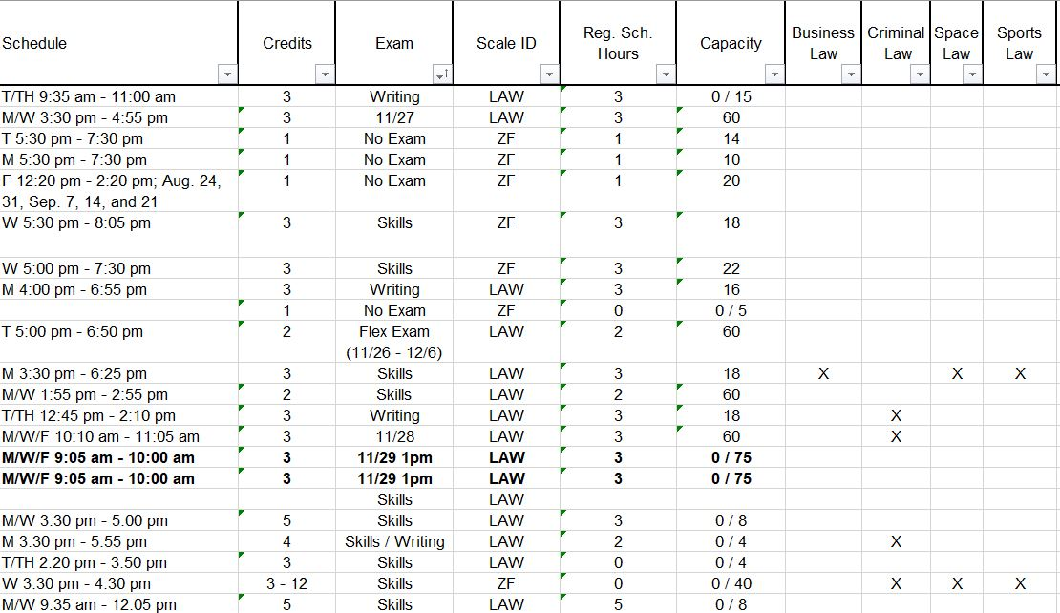
School of Law Website - Schedule
Class Schedule Details

Slide 9
Schedule
Waitlists
Set at 10% of Class Capacity
Exceptions:
Skills and Writing Courses set at 50%
No student self-registration

Slide 10
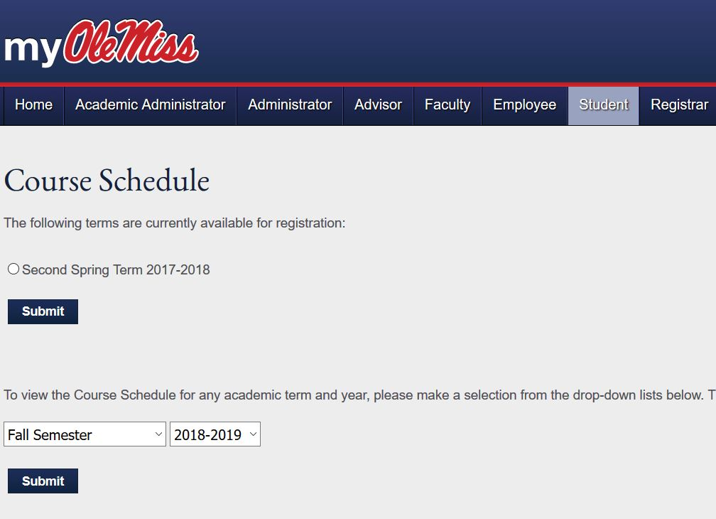
myOleMiss

Slide 11
myOleMiss - Registration
Best Practices (Tips)
Check your Holds!
Add possibilities to your Favorites
Do you meet the prerequisite or corequisites?
Does your class schedule have any overlaps?

Slide 12
myOleMiss - Registration
Best Practices (Tips)

Slide 13
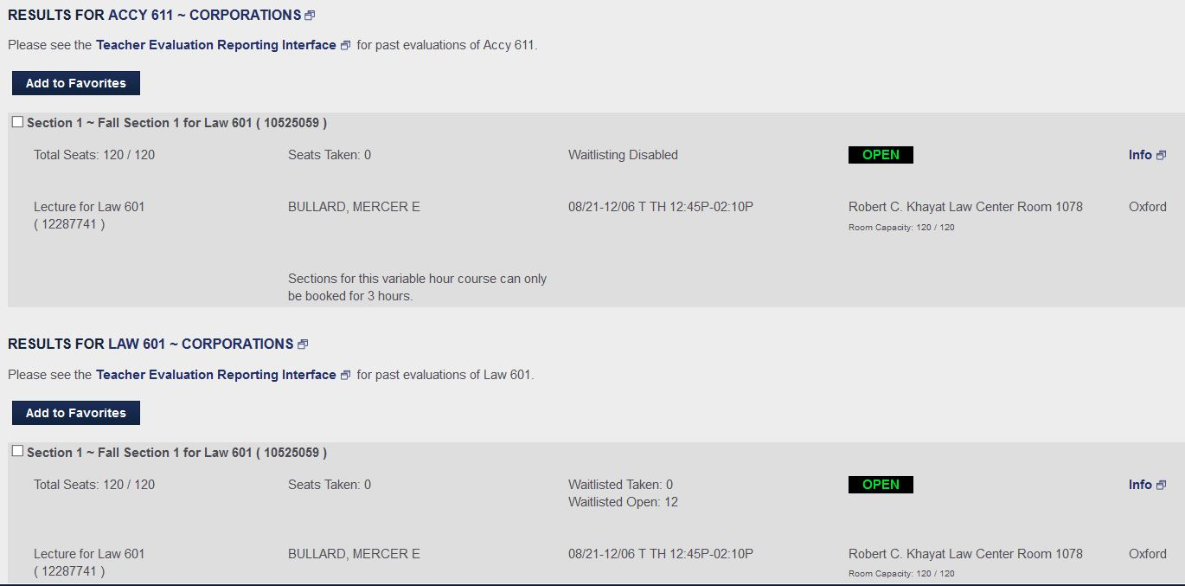
myOleMiss - Registration
Best Practices (Tips)

Slide 14
myOleMiss - Registration
Best Practices (Tips)
Add one class at a time
Highest priority class first
Small capacities first
One Skills course
One Writing course
> 18 hours
Law vs. Accy (Accy is first!)

Slide 15
Registration – by Law Registrar
How Do I…
Receive credit for co-curricular activities such as Law Journal, Space Law Journal, Moot Court Board, Trial Advocacy Board, and/or Negotiation Board.
Receive credit for advocacy competition, individual study, pro bono service and/or faculty research assistant.

Slide 16
myOleMiss – Contact Information
Note: Must Have Emergency Contact!

Slide 17
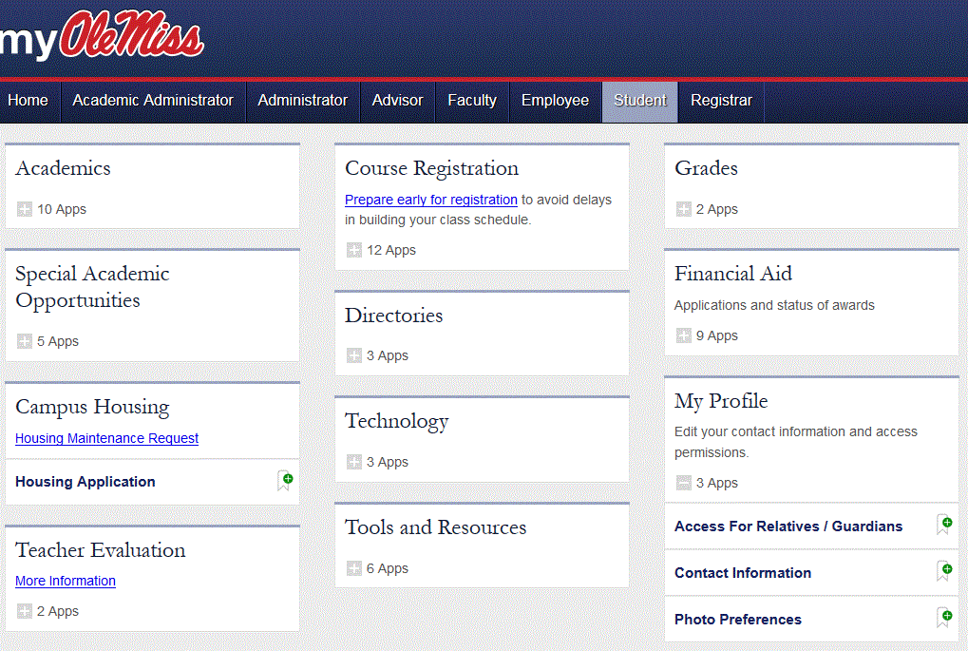
myOleMiss - Contact Information
Is Your
E-mail Full???

Slide 18
Law School Required Questions
Every Fall and Spring Required Questions Survey.
Disclose, disclose, disclose!!!

Slide 19
Other things…
Check your schedule after add/drop!
I’m charged tuition for what?
Certifications and letters – who do I ask?

Slide 20
Graduation Process
Apply for Graduation…
Intent to Graduate – due semester before
Statement of Completion for Certificate – due semester before

Slide 21
Include in E-mails to Law Registrar
Student Number
Like 106?????
Send from go.olemiss.edu

Slide 22
Law Registrar Contact Information
Eddie J. Upton
ejupton@olemiss.edu
Dean’s Suite
Room 2070

